Slide 1






Unit 3: Basic Structure of Computers

Slide 2
Definition of Computer
Computer is a fast electronic calculating machine that accepts digitized input information, processes it according to a list of internally stored instructions, and produces the resulting output information.
List of instructions is called Computer program.
Internal storage is known as Computer memory

Slide 3
Types of Computer
Many types of computers exists that differ widely in size, cost , computational power and intended use.
1. Personal or Desktop Computers
2. Notebook Computers
3. Workstation
4. Enterprise systems
5. Servers
6. Super computers

Slide 4
1. Personal Computers or Desktop computer: has found wide use in schools, homes and business offices.
2. Notebook: it is portable and compact version of personal computer with all the components like processor, storage units, visual display, audio output and a keyboard packaged into a single unit size of a thin briefcase.
3. Work station:
  High resolution graphics input capacity
  Significantly more computational power than PC
  Used in engineering applications especially for interactive design work
4. Enterprise system or Mainframes: used for business data processing in medium to large corporations that require more storage capacity and computational power than work stations.

Slide 5
5. Servers:
Sizable database storage units and are capable of handling large volumes of request to access data.
Used in education, business, personal user communities.
Request & responses are usually transported over internet.
6. Super Computer:
Used for large scale numerical calculations required in applications such as “weather forecasting and aircraft design and simulation”.

Slide 6
Functional Units of a computer
There are five basic independent functional units in a computer. Each performs different functions.
The functional units are :
1. Input unit
2. Memory unit
3. Arithmetic and Logic unit (ALU)
4. Control unit
5. Output unit

Slide 7
Functional Units
Input
ALU
Memory
Output
Control
I/O
Processor

Slide 8
1. Input Unit
Computer accepts coded information through input units , which read the data.
Input units are keyboard, mouse and joystick and touch screen monitor.
When a key is pressed on the input device the corresponding letter is automatically translated into its binary code and transmitted over cable to either memory or control unit.
Microphones can also be used as input unit which converts audio into digital codes.

Slide 9
2. Memory Unit
Memory unit is used to store programs or data or both for very short period of time or permanent as permitted by the user.
There are two types of storage; they are
  Primary storage and
  Secondary storage
Primary storage is a fast memory that operates at electronic speeds. When executing the programs must be stored in the memory up to certain time till the program gets executed.

Slide 10
Memory Unit…
The memory unit is made up of semiconductor storage cells each capable of storing one bit of information.
These cells are rarely read or written as individual cells but instead are processed in groups of fixed size called words.
The number of bits in each word is often referred to as the word length of the computer. (word length range from 16 to 64 bits)

Slide 11
3. Arithmetic and Logic Unit (ALU)
The operations like addition, subtraction, multiplication and division and other mathematical operations which takes in computer are processed by Arithmetic and Logic unit.
When two numbers are to be multiplied or subtracted they are brought to the ALU and the process is carried and then it is stored in the memory.
ALU is one of the fastest device connected the computer.

Slide 12
ALU…
Suppose two numbers located in the memory are to be added. They are brought into the processor , they are stored in high-speed storage elements called registers. and the actual addition is carried out by the ALU. The Sum stored in memory or retained in the processor for further use.
Each register can store 1 word of data.

Slide 13
4. Control Unit
Every operation which is carried out in the computer is controlled by control unit.
It can be called as the nerve center of the computer.
control unit supervises the flow of information between various units.
It retrieves the instructions one by one from the program which is stored in the memory.
For each instruction the control unit informs the processor to execute the operation specified by the instruction.

Slide 14
5. Output Unit
The output devices are used to record the results obtained by the computer and present them to the outside world.
The results are sent to the outside in the form of soft copy using monitor or hard copy using printer.
Output units are printers, monitors (graphic displays).

Slide 15
The operations of the functional units are as follows:
The computer accepts information in the form of programs and data through an input unit and stores it in the memory.
Information stored in the memory is fetched, under program control, into an arithmetic and logic unit, where it is processed.
Processed information leaves the computer through output unit.
All activities are monitored and controlled by the control unit.

Slide 16
Basic Operational Concepts
A program consist of instructions, these instructions are brought down to the memory and from memory into the processor, where the execution takes place.
A typical instruction may be
Add LOCA , R0
This instruction adds the operand at memory location LOCA to the operand in a Register R0 in the processor and places the sum into register R0.

Slide 17
Basic Operational Concepts: (Cont…..)
The original contents of LOCA are preserved where as those of R0 are overwritten several times.
Transfers between the memory and the processor are started by sending the address of the memory location to be accessed to the memory unit and issuing the appropriate control signals.
The data are then transferred to or from the memory.

Slide 18
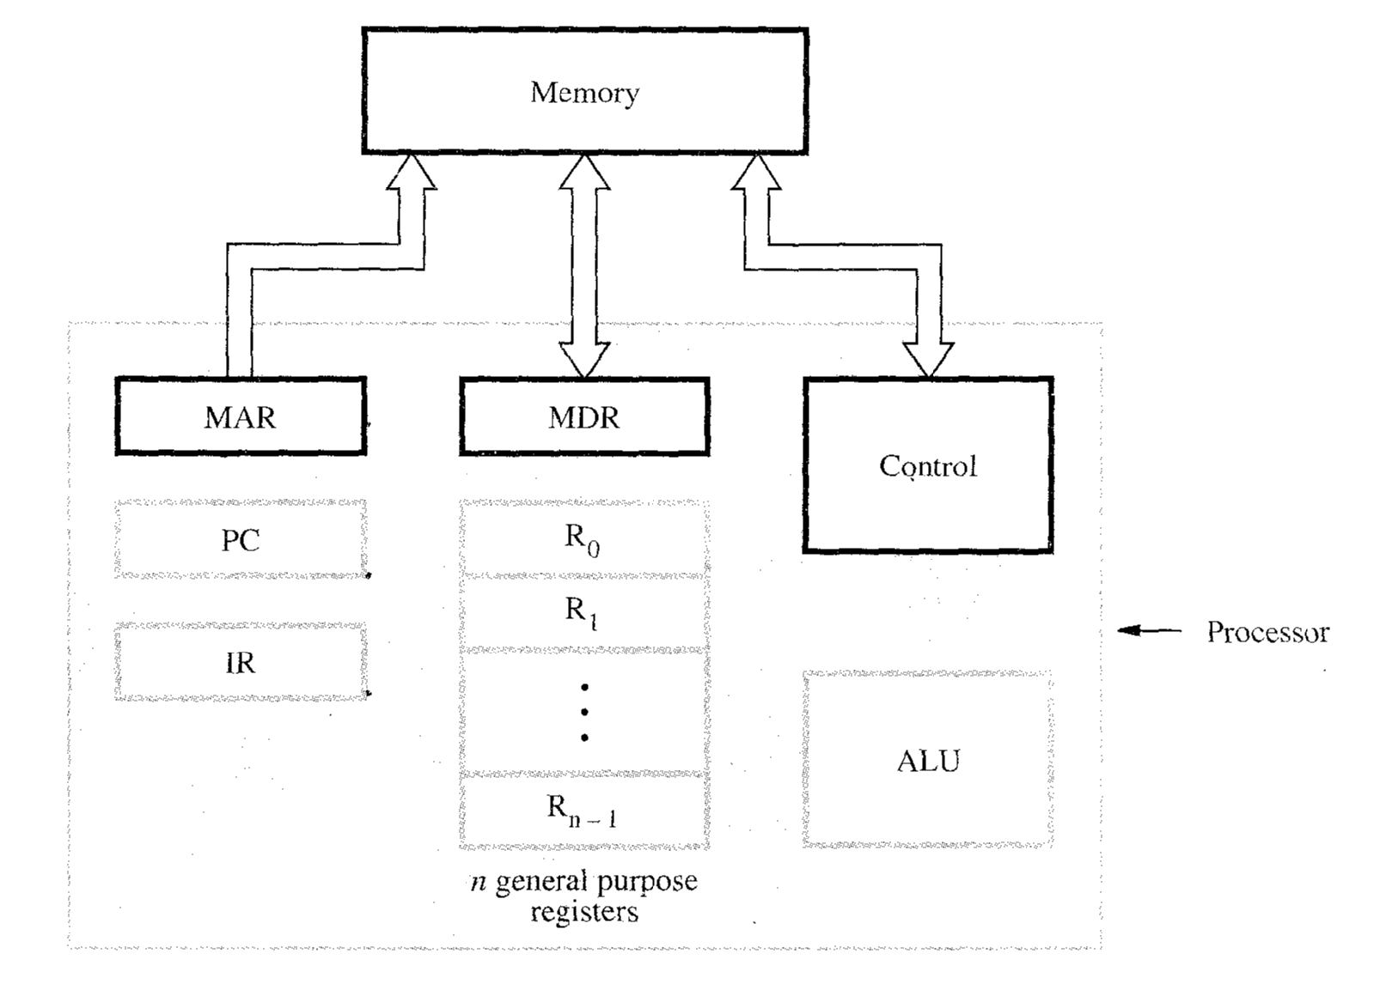

Slide 19
The figure below shows how the memory and the processor are connected.
It also shows the operational details of the processor .
ie, Connections between the processor and the memory.

Slide 20
The processor contains a number of registers used for different purposes.
The instruction register (IR) holds the instruction that is currently being executed.
The program counter (PC) is a specialized register which keeps track of the execution of a program.
It contains the memory address of the next instruction which is to be fetched and executed.

Slide 21
The Memory Address Register (MAR) holds the address of the location to be accessed.
The Memory Data Register (MDR) contains the data to be written into or read out of the addressed location.
There are ‘n’ general purpose registers which stores the contents.
Execution of the program starts when the PC is set to the point to the first instruction of the program.

Slide 22
The contents of the PC are transferred to MAR and a read signal is sent to the memory and the contents are loaded into the MDR.
Now the contents of MDR are transferred to IR where the instruction is ready to be decoded and executed.
If this instruction involves an operation to be performed by the ALU, its required operands are fetched by sending its address to MAR and initiating a read cycle.

Slide 23
Now the operand has been read from the memory into the MDR and transferred to ALU to perform desired operation.
The result of this operation is sent to MDR and stored in the memory.
The address of the location where the result is to be stored is sent the MAR and a write cycle is initiated.

Slide 24
During the execution of these instructions at some point of time the PC points to the next instruction to be executed.
Thus as soon as the current instruction is completed a new instruction fetch may be started.
The process is repeated until the program gets terminated .

Slide 25
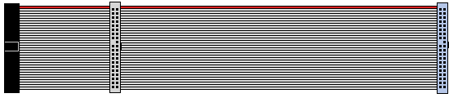
Bus Structure
A group of lines that serves as a connecting path for several devices is called a bus.
In addition to the lines that carry the data, the bus must have lines for address and control purpose.
The simplest interconnection between functional units is done by using single bus.

Slide 26
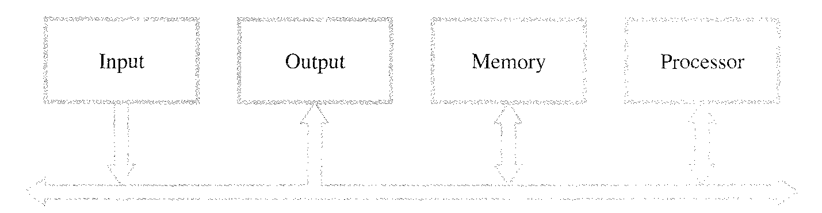
Single Bus Structure
When a word of data is transferred between units, all its bits are transferred in parallel i.e. bits are transferred simultaneously over many wires or lines, one bit per second.

Slide 27
Bus Structures (cont..)
Here all units are connected to a single bus because of which the bus can be used for one transfer at a time i.e. only two units can actively use the bus at any given time.
Single bus structure is vastly used because of its low cost and its flexibility for attaching peripheral devices.
Multiple bus structure systems achieve more concurrency in operations by allowing two or more transfers to be carried out at the same time which leads to better performance at an increased cost.

Slide 28
Three types of bus
Data bus: This is used to carry data from input devices or memory to the processor and vice versa to output device. Hence it is called bi-directional.
Address bus: The processor uses this bus to access the memory or any I/O device connected to it.
Control bus: These lines are needed to conduct various activities like read, write, reset etc.

Slide 29
Memory location and Addresses
Every information we store in the computer is stored in memory unit.
How memory is organized?
Memory consists of many millions of storage cells, each of which can store a bit of information having the value 0 or 1.
Single bit represents a very small amount of information.

Slide 30
Memory is organized such that a group of n-bits can be stored or retrieved in a single operation.
Hence n is called a word length and group of n-bits is referred to as word of information.
Word length can vary from 8 to 64 bits.

Slide 31
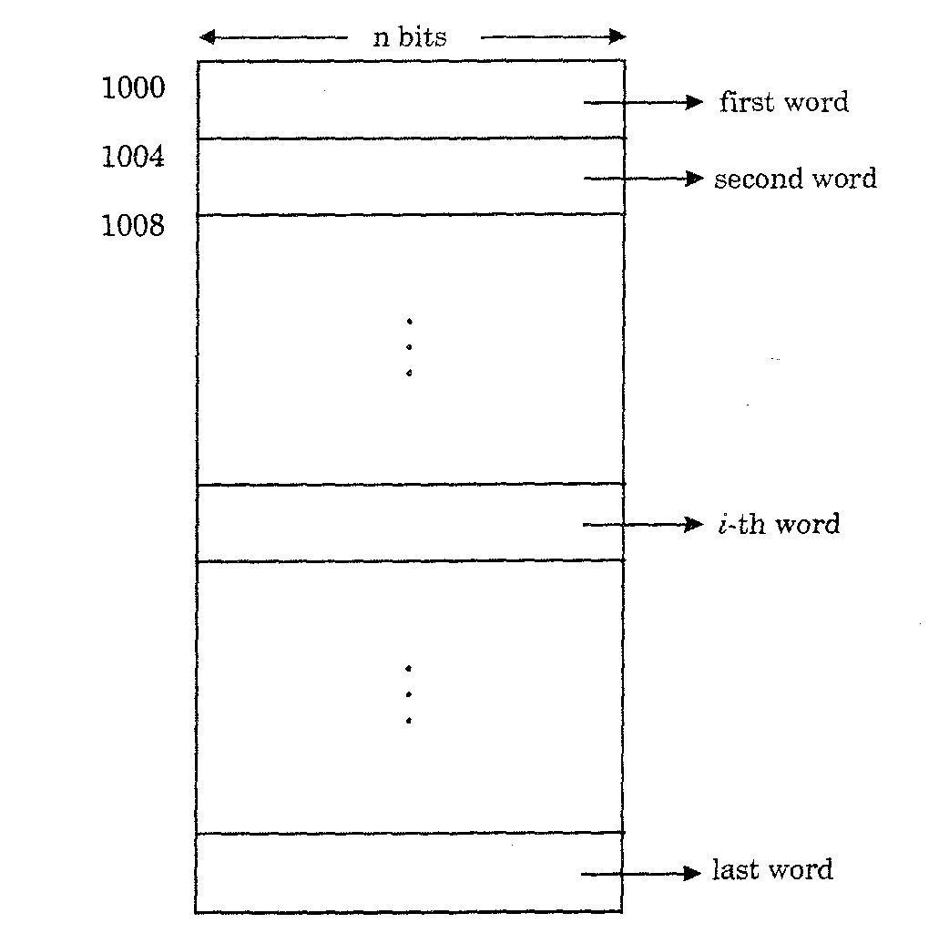
Representation of memory is as shown below

Slide 32
Memory Addresses (cont…..)
If the word length is 32-bits, then a memory word can store a 32-bit signed integer or four ASCII characters.
Accessing the memory for reading or writing an item requires distinct addresses for each location.

Slide 33
Byte Addressability :
Memory is arranged in such a way that successive addresses refer to successive byte locations.
Each location contains one byte of information which is called byte addressability.
If the word length is 32 bits, then they are divided into 4 bytes and stored in 4 consecutive address locations.
Successive words are located at addresses 0, 4, 8…. with each word having 4 bytes.

Slide 34
Representation of memory is as shown below

Slide 35
Memory Assignment
Byte addresses are arranged in two ways,
1. Big-endian assignment.
2. Little-endian assignment.
1.Big-endian assignment:
Here the byte of data is stored at lower address and low byte of data at lower address.
This is used in Motorola and Power PC processor.

Slide 36
Big-Endian: lower byte addresses are used for the most significant bytes of the word.
2.Little-endian assignment:
Here lower addresses contain high order bytes of data.
This is used in Intel processors .
Little-Endian: opposite ordering. lower byte addresses are used for the less significant bytes of the word

Slide 37
Big-Endian and Little-Endian Assignments
Big-Endian: lower byte addresses are used for the most significant bytes of the word. Little-Endian: opposite ordering. lower byte addresses are used for the less significant bytes of the word
W
ord
address
Byte address
Byte address
0
0
1
2
3
0
3
2
1
0
4
4
5
6
7
4
7
6
5
4
•
•
•
•
•
•
2
k
-
4
2
k
-
4
2
k
-
3
2
k
-
2
2
k
-
1
2
k
-
4
2
k
-
1
2
k
-
2
2
k
-
3
2
k
-
4
(a) Big-endian assignment
(b) Little-endian assignment
Figure 2.7. Byte and word addressing.

Slide 38
Memory Operations
Instructions as well as operands are stored in memory.
To execute an instruction, the processor has to obtain the data from memory using control signal.
The result of operation may also be copied to the memory.
Thus, two basic operations are performed with the memory.----
  Load (Read or fetch) ,
  Store (write)

Slide 39
1. Load:
Load operation transfers a copy of the contents of a specific memory location to the processor. But the memory content remain unchanged.
i.e., The processor sends the address of the desired memory location and executes read control signal to memory to request the data and memory sends the data to the processor which gets stored in the processor register.
Here, content of specified memory location moves to the processor register.

Slide 40
2. Store:
The store operation transfers an item of information from processor to a specific memory location.
The processor sends the address of the desired location to the memory, together with the data to be written into that location.
One word or one byte of information item can be transferred between the processor and memory in a single operation.

Slide 41
Instruction and Instruction Sequencing
To perform any operation in a computer, instructions are required.
  For Ex: Adding two numbers, reading a character from keyboard, testing for particular condition, sending a char to be displayed on screen etc.
A computer have instructions capable of performing 4 types of operations. Such as:
i) Data transfer between memory and processor
registers.
ii) Arithmetic and logic operations on data.
iii) Program sequencing and control.
iv) I/O transfers.

Slide 42
Instruction and Instruction Sequencing
A complete instruction set is referred to as Instruction Set Architecture (ISA) of the processor.
There are two types of representing an instruction. They are,
1. Register Transfer Notation (RTN).
2. Assembly Language Notation.

Slide 43
1.Register Transfer Notation(RNT):
Which describes the transfer of information from one location to another location.
Possible locations are memory locations, Processor registers & registers in the I/O subsystems.
Memory location is identified by a symbolic name in upper case alphabets. The name indicates its address.
Eg: LOCN, NUM , PLACE, A, VAR2 etc indicate memory locations.

Slide 44
Register Transfer Notation…
Processor registers are indicated by an upper case alphabet followed by a numeral such as R1, R2 etc.
I/O register names are expressed as DATAIN, OUTBUFFER , OUTSTATUS etc.
The content of a location is denoted by placing square brackets around the name of the location.
The right hand side of an RTN expression always denotes a value and the left hand side is the symbolic name where the value is to be stored.

Slide 45
Register Transfer Notation…
All RTN statements will have an arrow symbol, whose left side is the destination and the right side is the source.
Source contents are not modified. Destination contents are changed.

Slide 46
Example--RTN
R1← [LOCN]
This operation transfers the contents of memory location LOCN into processor register R1.
The contents of LOCN are not changed, but the previous content of R1 is lost.

Slide 47
Example--RTN
R3 ← [R1] + [R2]
This will add the contents of two registers R1and R2 and place the sum into register R3.
RTN notation is easy to understand, but cannot be used to represent machine instructions.

Slide 48
2.Assembly Language Notation:
The processor can understand only binary format, so we need a notation which could convert to machine language format.
To do this we need a new format called Assembly language Format. Here only simple English words are used to represent an operation uniquely.
For ex: Move Loc, R
Add R1, R2, R3

Slide 49
2.Assembly Language Notation--Example
Move LOCN, R1
Here the content of LOCN is moved to processor register R1.
Add R1, R2, R3
Here the contents of R1 and R2 gets added and is stored in R3.

Slide 50
Instructions formats/Types
There are four types of instruction formats to perform the operations . They are,
Three address instruction.
Two address instruction.
One address instruction.
Zero address instruction.

Slide 51
1.Three address instruction:
Format:
Operation Source1, Source2, Destination
Example-- Add A, B, C
It contains three address fields, each providing the address of one of the three operands-A, B , C.
Here Add is the operation to be performed. A and B are source operands and C is the destination operand.
Disadvantage of this is that instruction code will be too large to fit in one word location in memory.

Slide 52
2.Two address instruction:
Format:
Operation Source, Destination
Example 1: Add A, B
This performs the operation
B ← [A ]+ [B]
when sum is calculated, result is sent to memory and stored in location B.

Slide 53
Two address instruction: (cont..)
Example2: Move A, C
Add B, C
Here ‘Move’ is actually a copy operation since it does not change the source operand.
The contents of A are moved to C and stored in C, and contents of B are added to C and stored in C.

Slide 54
3.One address instruction:
Format:
Operation Source/ Destination
The instruction specifies only memory operand which may be source or destination.
The other operand is implied to be a processor register called accumulator.

Slide 55
One address instruction like:
Load A ( load instr copies the content of accumulator into memory loc A)
Add B ( adding accumulator and B and store result in Accumulator
Store C ( content of accumulator is transferred to c memory location)

Slide 56
4.Zero address instruction:
Certain instructions in which the locations of all the operands are defined implicitly. Such instructions are found in machines that store operands in structure called as pushdown stack. These type of instructions are called zero address instruction.
Example---PUSH, POP etc

Slide 57
Instruction Formats
Example: Evaluate (A+B) ∗ (C+D)
Three-Address
  ADD A, B,R1 ; [R1] ← M[A] + M[B]
  ADD C, D, R2 ; [R2 ]← M[C] + M[D]
  MUL R1, R2,X ; M[X] ← [R1] ∗[R2]

Slide 58
Instruction Formats
Example: Evaluate (A+B) ∗ (C+D)
Two-Address
  MOV A,R1 ; [R1 ]← M[A]
  ADD B, R1 ; [R1] ← [R1] + M[B]
  MOV C, R2 ; [R2] ← M[C]
  ADD D , R2 ; [R2 ]← [R2] + M[D]
  MUL R2,R1 ; [R1 ]← [R1] ∗ [R2]
  MOV R1, X ; M[X] ← [R1]

Slide 59
Instruction Formats
Example: Evaluate (A+B) ∗ (C+D)
One-Address
  LOAD A ; [AC] ← M[A]
  ADD B ; [AC] ← [AC] + M[B]
  STORE T ; M[T] ← [AC]
  LOAD C ; [AC] ← M[C]
  ADD D ; [AC] ←[ AC] + M[D]
  MUL T ; [AC] ← [AC] ∗ M[T]
  STORE X ; M[X] ← [AC]

Slide 60
Instruction Formats
Example: Evaluate (A+B) ∗ (C+D)
Zero-Address
  PUSH A ; TOS ←[ A]
  PUSH B ; TOS ← [B]
  ADD ; TOS ← (A + B)
  PUSH C ; TOS ←[ C]
  PUSH D ; TOS ← [D]
  ADD ; TOS ← (C + D)
  MUL ; TOS ← (C+D)∗(A+B)
  POP X ; M[X] ← TOS

Slide 61
Instruction Execution and Straight Line Sequencing
Let us consider the problem C ← [A] + [B]
This can be solve as shown below using two address instructions.
Move A, R1
Add B, R1
Move R1, C
This program segment appears in memory as shown in fig

Slide 62
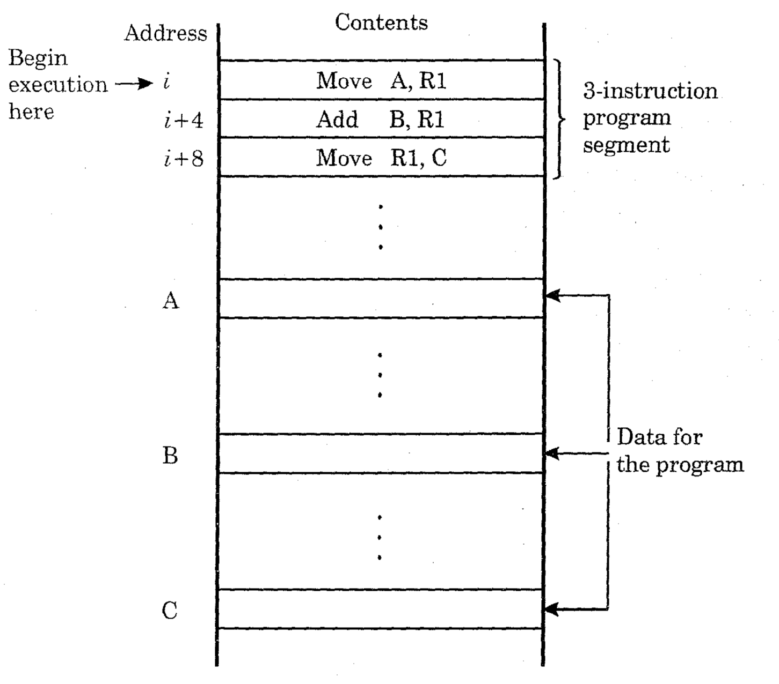

Slide 63
Instruction Execution and Straight Line Sequencing (cont..)
Assume word length is 32-bit and the memory is byte addressable.
The instructions are stored in successive memory locations starting at location i. since each instruction is 4 bytes long successive instructions start at addresses i+4, i+8 and so on.
How program is executed?

Slide 64
Instruction Execution and Straight Line Sequencing (cont..)
PC ( program counter) register in processor holds the address of the instruction to be executed next.
Initially, the address of the first instruction (i) is loaded into PC.
Now, the control circuitry will start fetching the instructions one by one from successive addresses in memory and executes them. This is called Straight line sequencing.
During the execution of each instruction, PC is incremented by 4 to point to the next instruction.

Slide 65
(cont..)
The complete operation is performed in two phases.
In the first phase called instruction fetch, the instruction is fetched from the memory location and placed in the instruction register (IR) of the processor.
At the start of next phase called instruction execute, the contents of IR is decoded to determine which operation is to be performed.
The specified operation is then performed by the processor.

Slide 66
Branching
Let us consider adding a list of n numbers. The program structure is shown below.
The addresses of the memory locations are symbolically given as NUM1, NUM2 … NUMn and a separate Add instruction is used to add each number to the contents of register R1.
After all the numbers have been added, the result is placed in memory location SUM.

Slide 67
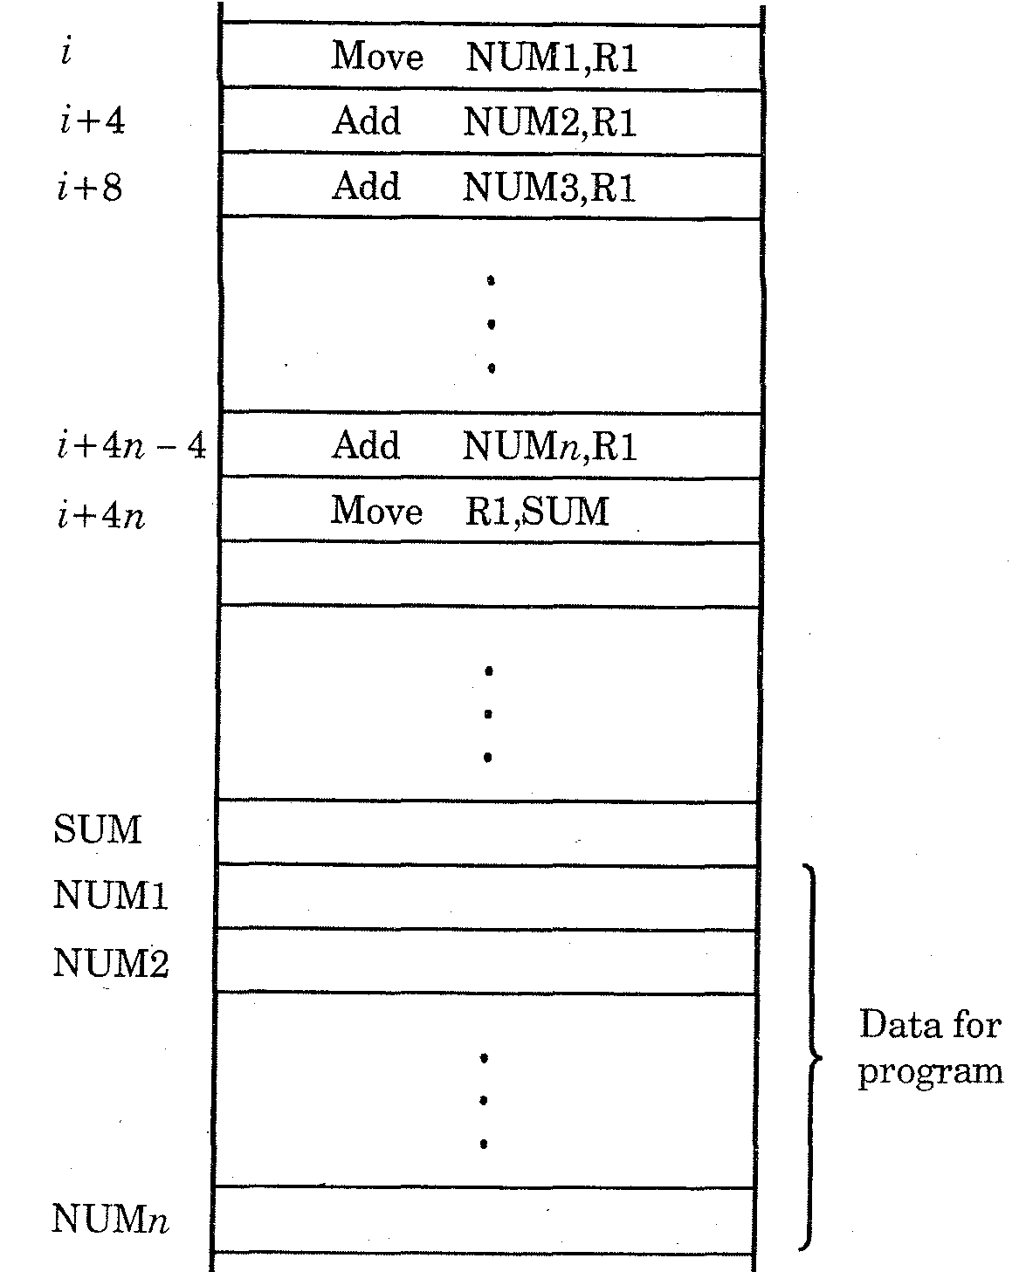

Slide 68
Branching (cont..)
Instead of using long list of Add instructions, it is possible to place a single Add instruction inside a program loop as shown in Fig below.

Slide 69
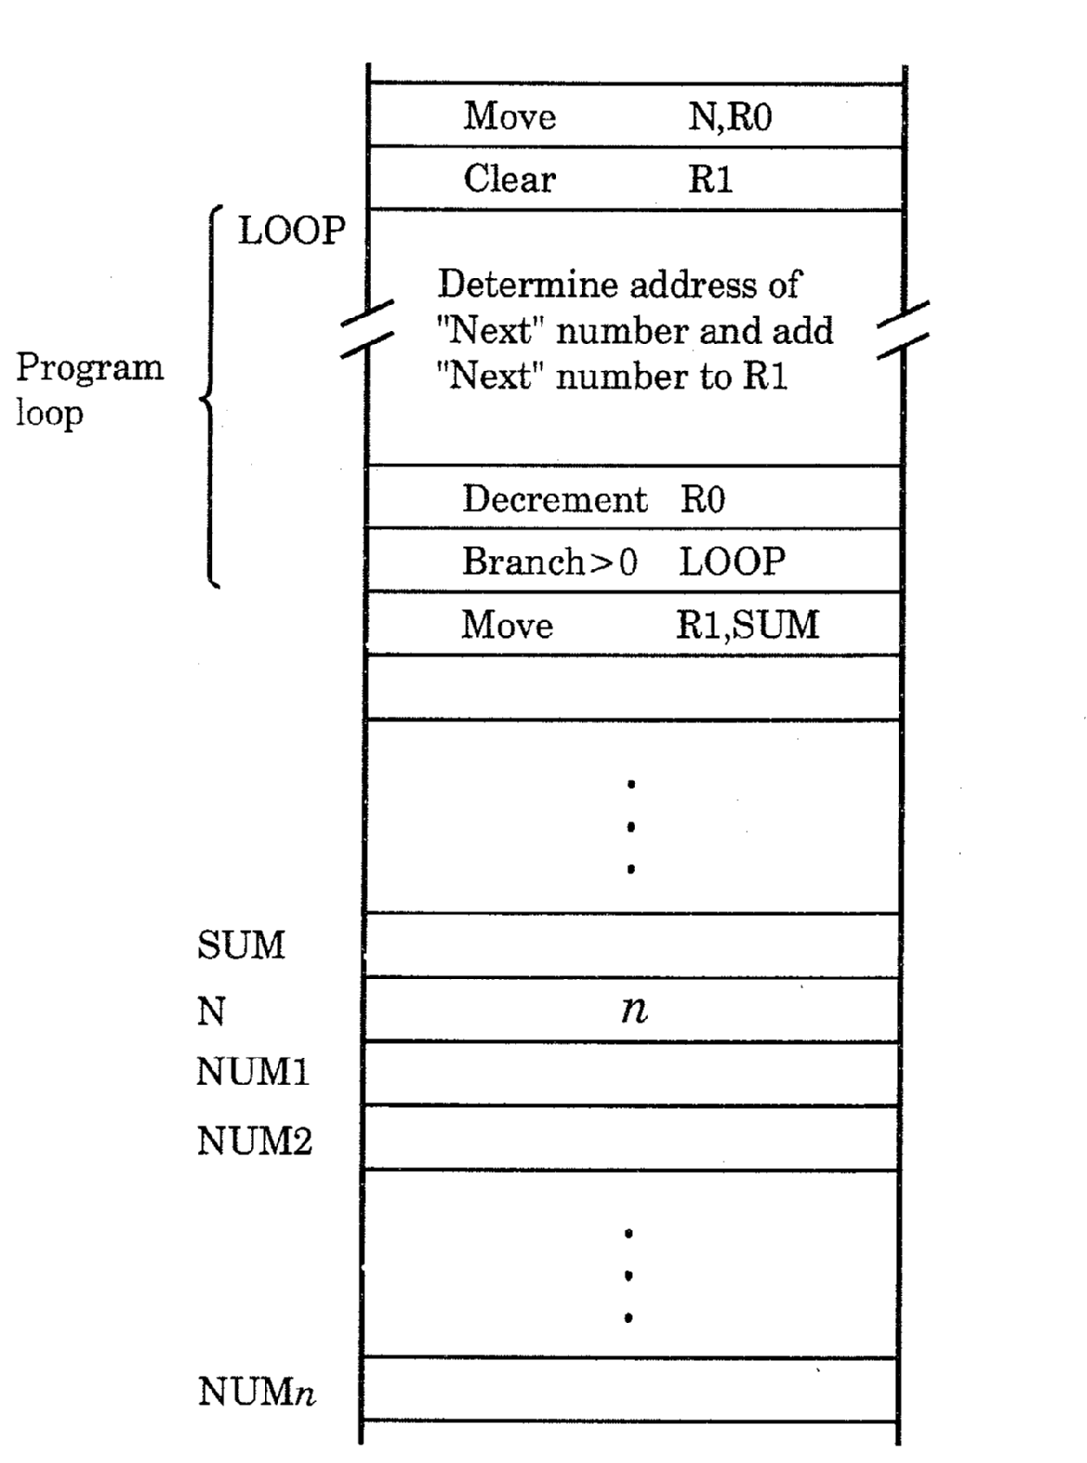

Slide 70
Branching (cont..)
The sequences of instructions inside the loop are executed as many times as needed.
During each pass, the address of the next number in the list is determined; the data at that location is fetched and then added to register R1.
Let n (the number of entries in the list) be stored in memory location N.

Slide 71
Branching (cont..)
Register R0 is used as a counter to check how many times the loop should be executed.
Therefore, R0 contains the contents of location NUM, i.e., value ‘n’.
Within the body of the loop, the instruction,
Decrement R0
decreases the contents of R0 by 1 for every pass through the loop.

Slide 72
Branching (cont..)
Execution of the loop is repeated as long as R0 is
greater than zero.
There is a special instruction Branch>0 LOOP in
the program. This type of instruction loads a new value into the PC.

Slide 73
Branching (cont..)
Now, the processor fetches and executes the instruction at this new address called branch target instead of going to the next instruction sequentially.
The program control can be changed conditionally or unconditionally.
A conditional branch instruction causes a branch only if the specified condition is satisfied.

Slide 74
Branching (cont..)
If not, the PC is incremented to fetch the next instruction in sequence.
The instruction Branch> 0 LOOP is a conditional branch instruction that causes a branch to location LOOP if the result of the immediately preceding instruction (Decrement R0) is greater than zero.
That is, the loop is repeated as long as there are data in the list to be added to R1.

Slide 75
Branching (cont..)
At the end of n^{th} pass, decrement instruction produces a value zero.
Now, the condition fails and branching will not occur.
So, the next Move instruction is executed and the addition result in R1 is moved to memory location SUM.

Slide 76
Condition Codes :
The results of various operation obtained by conditional branch instructions are recorded in individual bits, often called condition code flags.
The flag is nothing but a flip-flop which can be set to 1 or cleared to 0 depending on the outcome of the Arithmetic and/or Logic operation performed.
These flags are grouped together in a special processor register called condition code register or status register.

Slide 77
Condition Codes :
Four commonly used flags are:
N (Negative) ← Set to 1 if the result is negative; else cleared to 0.
Z (Zero) ← Set to 1 if the result is zero; else cleared to 0
V (Overflow) ← Set to 1 if arithmetic overflow occurs; else cleared to 0
C (Carry) ← Set to 1 if carry-out results from the operation; else cleared to 0.

Slide 78
Addressing Modes
Programs are normally written in a high-level language.
To translate high-level language program into assembly language, the compiler will perform this task using the instruction set provided in computer.
The different ways in which the location of an operand is specified in an instruction are referred to as Addressing modes.
Commonly used types of addressing modes in processors is given in the below table.

Slide 79
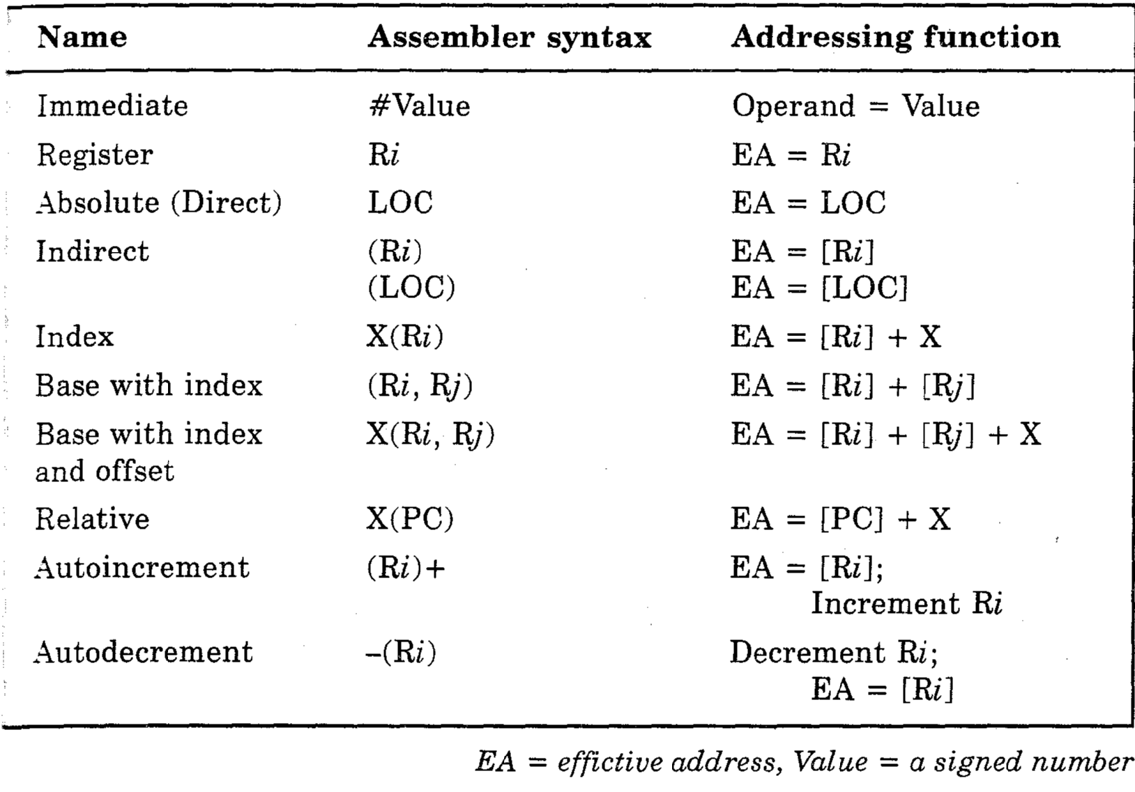
Addressing Modes

Slide 80
There are various addressing modes . They are:
Immediate
Direct
Indirect
Register
Register indirect
Displacement
Stack

Slide 81

1. Immediate Mode:
In this mode, the operand is specified in instruction itself.
i.e, an immediate-mode instruction had an operand field rather than an address field.
Immediate mode instructions are useful for initializing registers to a Constant value.

Slide 82
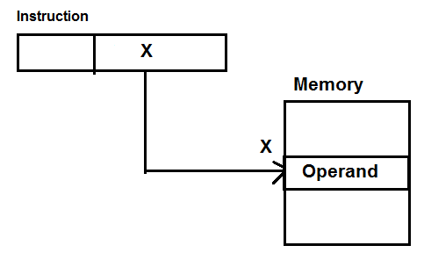
2. Absolute (Direct) Mode:
The operand is in a memory location.
The absolute address of this location is given in the instruction explicitly.
This mode is typically used to load operands and values of variables into CPU
Effective Address
EA= X
Ex... Move LOC, R1
Ex... Move LOC, R1

Slide 83
3. Indirect Mode
The problem with direct addressing is that the length of the address field is usually less than the word length. Thus limiting address range.
One solution is to have the address field refer to the address of a word in memory which in turn contain a full length address of the operand. This is known as indirect addressing mode.
In indirect addressing mode, the address field of the instruction gives the address where the effective address (EA) is stored in memory.

Slide 84
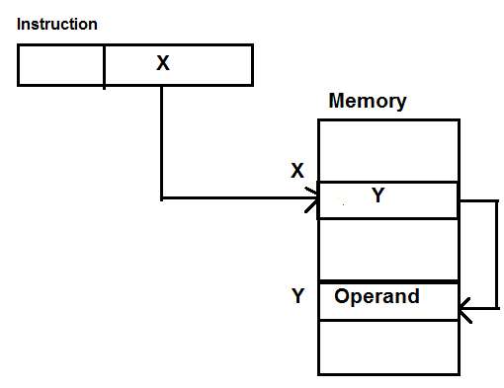
Control fetches the instruction from memory and uses its address part to access memory again to read the EA.
EA=[X]

Slide 85
Indirect Mode…
Example:
Move B, S
[S] = X
[x] = Operand
Here [X] represent content of X
and [S] represents symbolic memory location

Slide 86
4. Register Mode
It is conceptually same as direct addressing but specifies a register instead of a memory location
In this mode operands are in registers that resides with in CPU.
The particular registers selected from a register field in the instruction. A k-bit field can specify any one of 2k registers.
Ex… Move R1, R2; Copies the contents of register R1 into register R2
Add R0, R1; adds the contents of register R0 to R1 and places the sum in register R1.

Slide 87
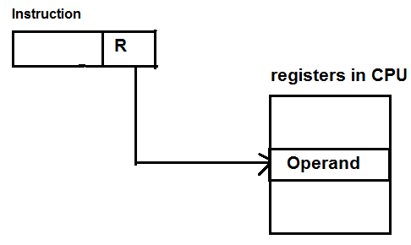
Advantage: here only a small address field reference are required

Slide 88
5. Register Indirect Addressing:
In this mode, the instruction specifies a register in the CPU whose contents give the address of the operand in memory.
In other words, the selected register contains the address of operand rather than the operand itself.

Slide 89
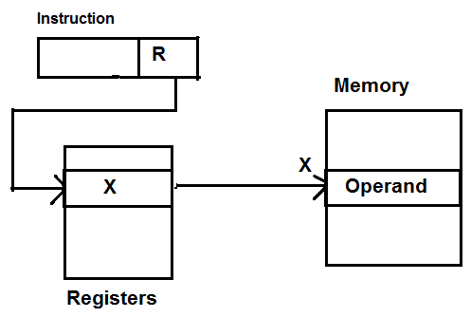
EA= [R]

Slide 90
6. Displacement Addressing
This mode combines the capabilities of Direct addressing and Register Indirect addressing.
This mode requires that the instruction have two address fields, atleast one of which is explicit.
The value contained in one address field ( value=A) is used directly.
The other field, or an implicit reference based on opcode refers to a register whose contents are added to A to produce the effective address
EA= A + [R]

Slide 91
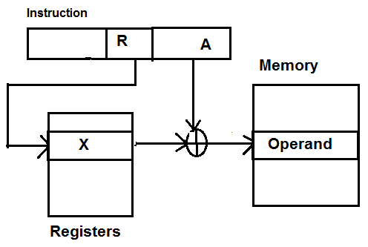


Slide 92
The three most common uses of displacement addressing are:
Relative Addressing
Base Register Addressing
Indexing

Slide 93
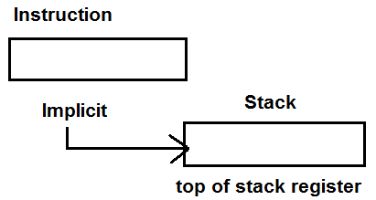
7. Stack Addressing
A Stack is a linear array of locations. It is also referred as Last_In_First_Out ( LIFO) queue or pushdown list.
The stack is a reserved block of location. Items appended to the top of the stack. A pointer is associated with the stack whose value is address of the top of the stack.
EA= TOS

Slide 94
End of Unit 3

